Slide 1






Bootcamp
Virtual Calls
Basic Level
Carolina Gomez Melendez
May 27th , 2024

Slide 2
Table of content
1
Review
2
IT Acronyms and Vocabulary
3
Phone Vocabulary

Slide 3
What did we do last class?
Roles & Tasks in IT
IT Technology
Here
New Vocabulary
https://wordwall.net/es/resource/22542796/technology

Slide 4
Warm up
Look at the following words and acronyms. ¿Do you know what do they refer to?
https://yotelecom.co.uk/telecoms-glossary-acronyms-explained/
IP
ISP
LAN
WAN
VPN
DNS
HTTP
VOIP
SIP
Server
Router
IP Address
ADSL
DDI
PBX
PTSN
ISDN
https://wordwall.net/es/resource/73945583/glossary-acronyms-virtual-calls

Slide 5

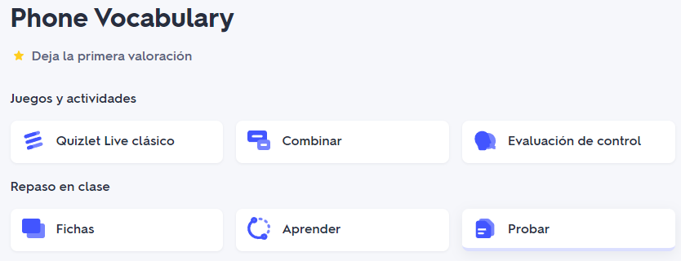
Phone Vocabulary
Check the following vocabulary flashcards.
https://quizlet.com/pa/818967523/phone-vocabulary-flash-cards/?new

Slide 6
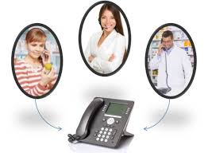


Activity
Read the situations 1-5 and match them to A - E
1. Hi, I'm having trouble accessing the database. It's showing an error message.
2. I need to update the software on my computer. Can you guide me through the process?
3. I've submitted a support ticket earlier. Can you provide an update on its status?
4. Thank you for your assistance. Is there anything else I should know?
5. How long will it take to resolve this issue with the network connection?
A. Sure, let me check the status of your ticket for you.
B. Could you please provide me with your account information?
C. I'm sorry to hear that. Let's troubleshoot the issue together.
D. Thank you for calling. Let me help you with that.
E. Our technicians are currently working on it. It should be resolved within the next hour."
Notes:
Key answers:
1. C
2. D
3. A
4. B
5. E

Slide 7
Activity
Read the situations 1-5 and match them to A - E
1. Hi, I'm having trouble accessing the database. It's showing an error message.
2. I need to update the software on my computer. Can you guide me through the process?
3. I've submitted a support ticket earlier. Can you provide an update on its status?
4. Thank you for your assistance. Is there anything else I should know?
5. How long will it take to resolve this issue with the network connection?
A. Sure, let me check the status of your ticket for you.
B. Could you please provide me with your account information?
C. I'm sorry to hear that. Let's troubleshoot the issue together.
D. Thank you for calling. Let me help you with that.
E. Our technicians are currently working on it. It should be resolved within the next hour."
Notes:
Key answers:
1. C
2. D
3. A
4. B
5. E

Slide 8

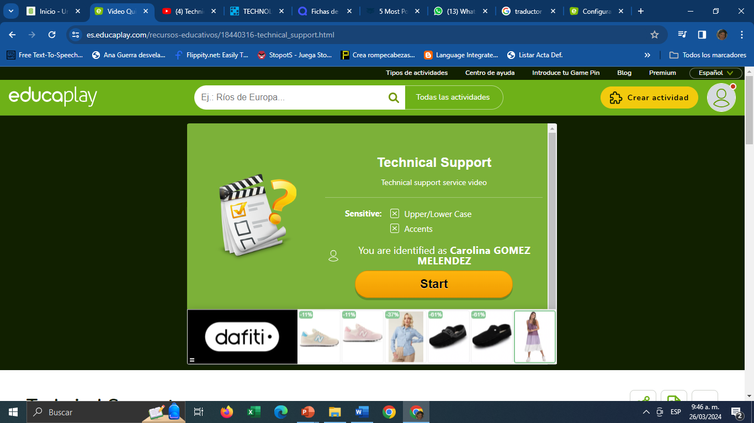
Virtual Calls
Watch the video and answer the questions.
https://es.educaplay.com/recursos-educativos/18440316-technical_support.html
https://www.youtube.com/watch?v=gLNAF9C39SI
Notes:
Video: https://www.youtube.com/watch?v=gLNAF9C39SI&t=34s&ab_channel=MagellanSolutionsOutsourcingInc.

Slide 9
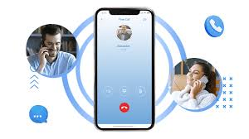
Reading Activity:VIRTUAL CALLS
A virtual phone call is when two people talk on the phone using the internet instead of regular phone lines. It's also called a VoIP call. People use special apps or systems for these calls, like KrispCall, RingCentral, or Nextiva, which have cool features like recording calls, having meetings, and sending calls to different people.
You can also make these calls using apps like Skype, Zoom, Google Meet, or Microsoft Teams, but you need to be connected to the internet via WiFi.
Virtual phone calls are getting more popular because they are cheap, flexible, and have cool features.

Slide 10
VIRTUAL CALLS
*Their device changes the data back into your voice, so they can hear you.
What are the benefits about Virtual Phone Calls? Virtual phone calls have many good things about them:
Work from Anywhere
You can make and get virtual phone calls from anywhere in the world if your device is connected to the internet. This means you can work from any place and talk to your clients and teams, no matter where you are. This is really helpful for freelancers and businesses with teams spread out in different locations.
How Do Virtual Phone Calls Work?
Virtual phone calls work with VoIP technology. VoIP changes your voice into data and sends it over the internet. This lets you talk on the phone using devices like phones, computers, or tablets.
Here's how it works:
*You use a VoIP app to call someone.
*The app tells your phone company you want to call someone.
*The company sends your call to the person you want to talk to.
*Your voice turns into data and travels to the other person's device.

Slide 11

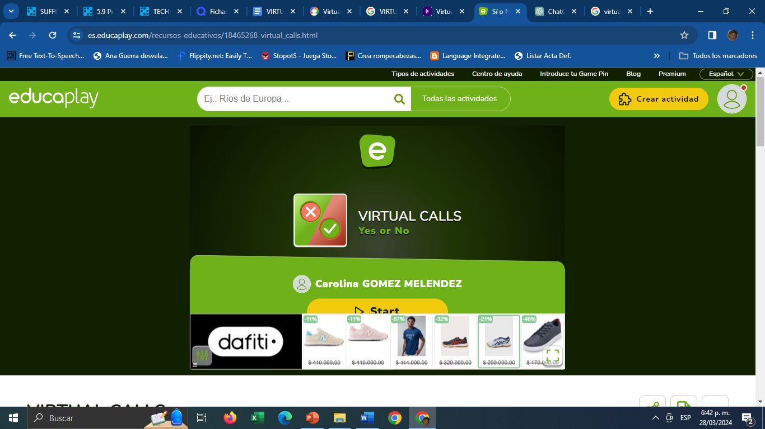
Virtual Calls
Read carefully and choose YES or NO
https://es.educaplay.com/recursos-educativos/18465268-virtual_calls.html

Slide 12
VIRTUAL CALLS
Also, you can use one phone number on different devices, making it simple for teams to collaborate.
Look Like You're in Other Countries
Using virtual phone numbers and services, businesses can seem like they have a local office in different places without actually having one. This is useful for companies that want to connect with potential customers in other countries.
Save Money on Travel
Traveling for work costs a lot of money, not just for flights but also for hotels and food. Instead of spending all that money and effort to travel and meet clients in person, you can just make a virtual phone call. Even if you're far away or in another country, virtual phone calls let you work together with clients without being there physically.
Help Teams Work Together from Far Away
Virtual phone systems have extra features like sharing files, showing your screen, and messaging instantly. These features make it easier for team members to talk in real-time, share what's on their screens, and work on projects together no matter where they are.

Slide 13
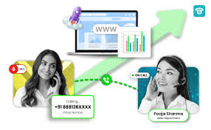
VIRTUAL CALLS
Why do Businesses Like Virtual Phone Calls?
Here are some reasons why businesses switch to virtual phone calls:
1.Saving Money: Virtual phone calls are often cheaper than regular phone services, especially for long-distance and international calls.
2.Flexibility: Businesses can make and get virtual phone calls from anywhere in the world as long as they have internet.
3.Moving Around: Because virtual phone calls don't depend on traditional phone lines, businesses don't miss important calls when they're traveling.

Slide 14
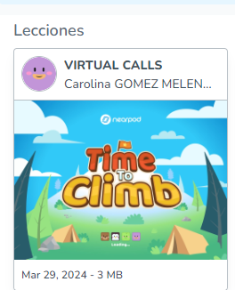
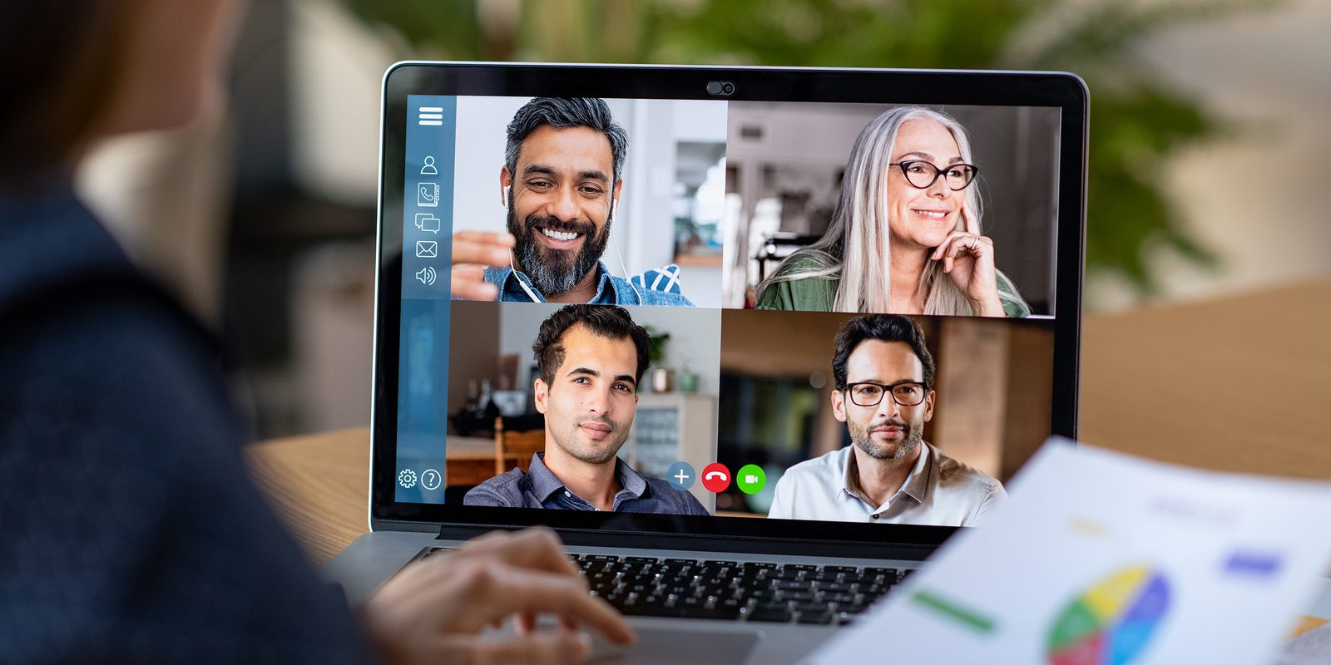
Virtual Calls
It is time to check your understanding. Let’s play…
https://np1.nearpod.com/sharePresentation.php?code=3f6551d19b304764319385c40e0a4042-1&oc=user-created&utm_source=link

Slide 15
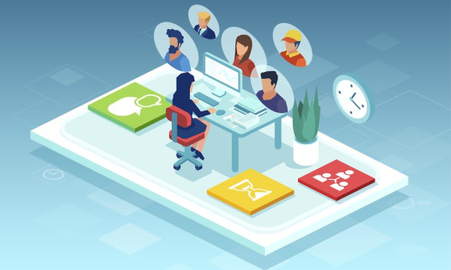
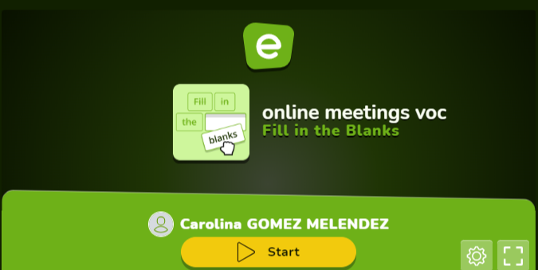
Virtual Calls
Read carefully and complete the conversation
https://es.educaplay.com/recursos-educativos/18465381-online_meetings_voc.html

Slide 16
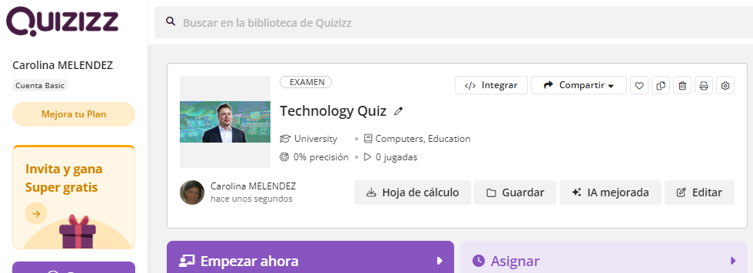
Virtual Calls
QUIZ
https://quizizz.com/admin/quiz/66552f3f3b5db03f5b119281?fromSearch=true

Slide 17


Slide 18

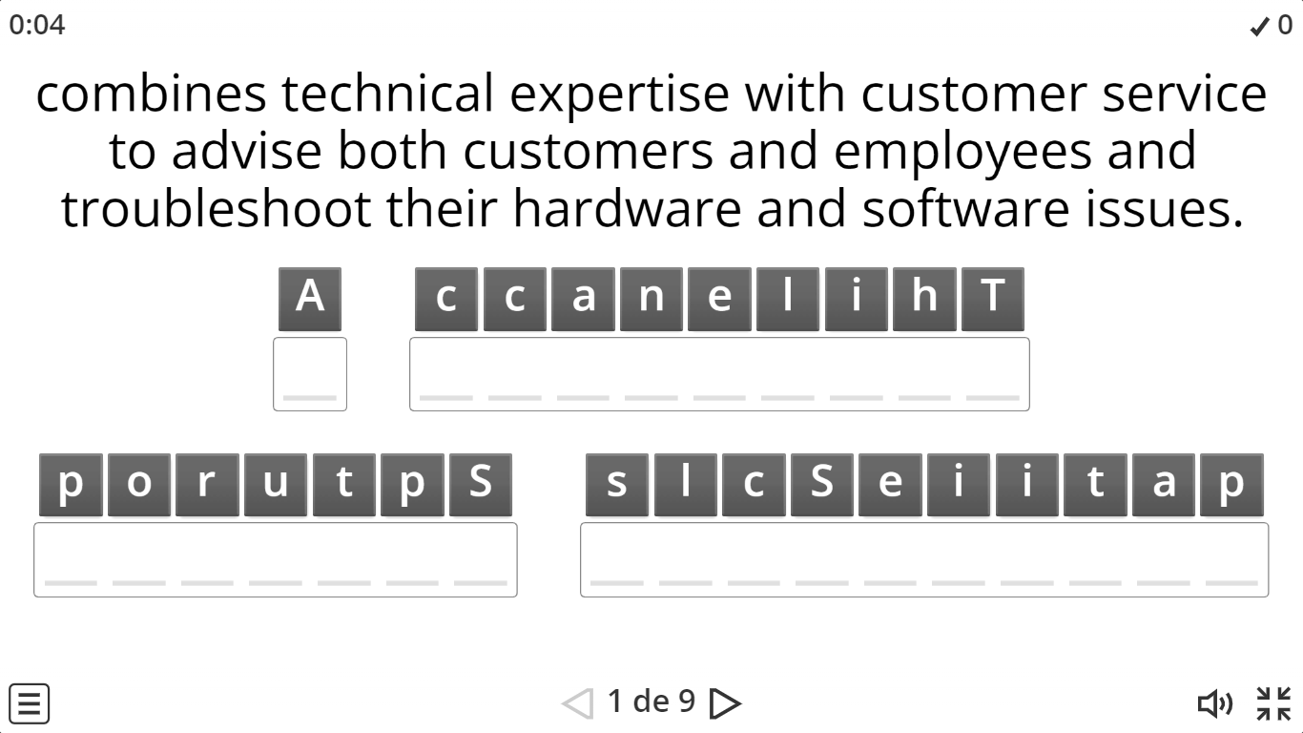
REVIEW ANAGRAM
Read the definition and unscramble the letters to get the job.
https://wordwall.net/es/resource/70654305/jobs-in-it

